Slide 1
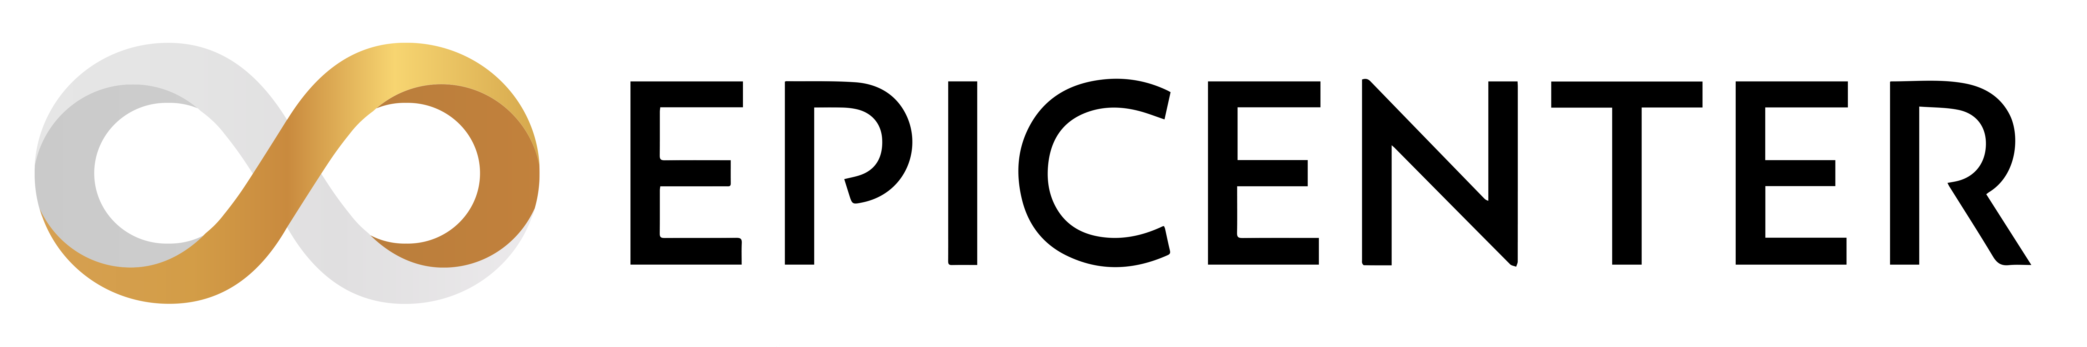



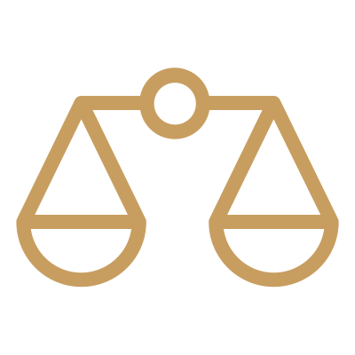
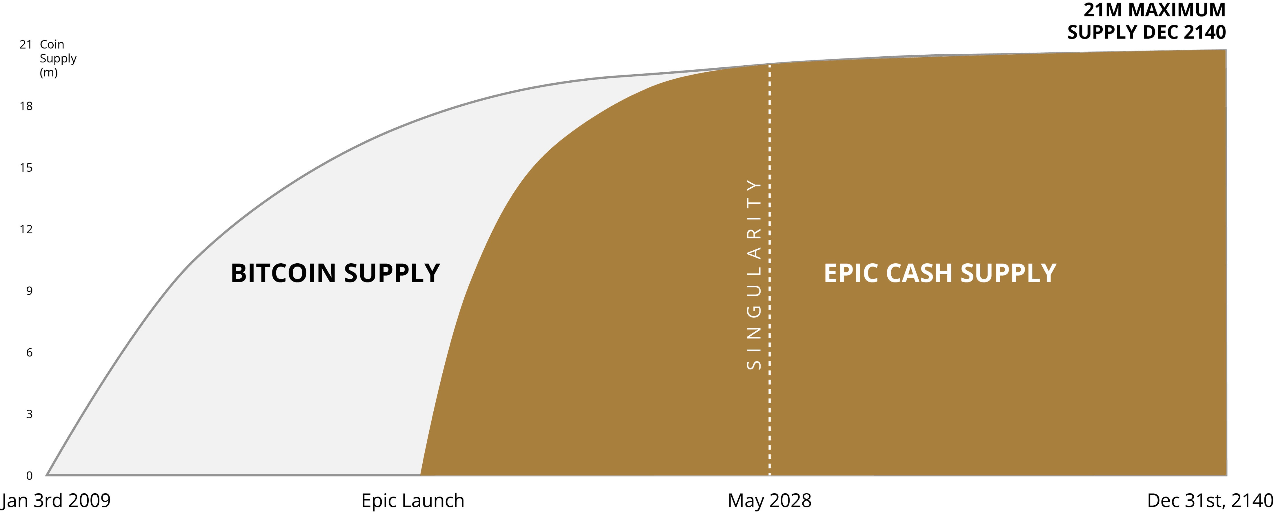
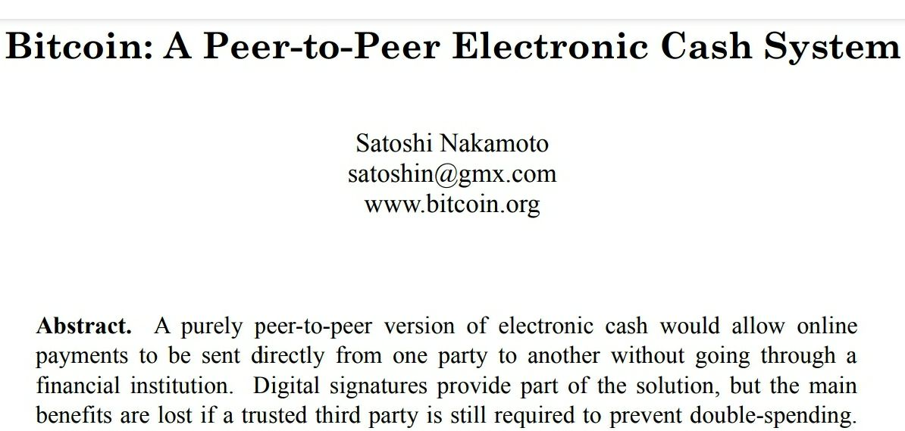
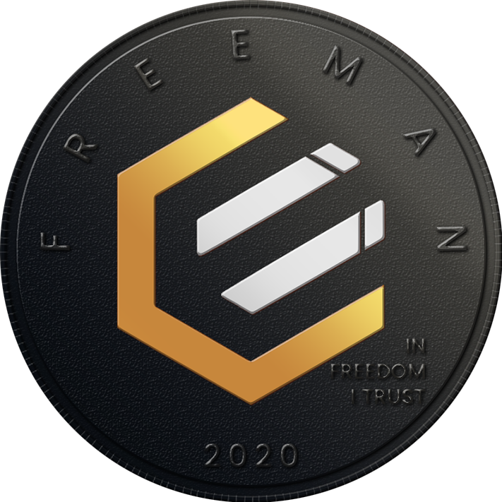

Engineered for Compatibility with Regulations
NO ICO
NO Pre-mine
NO VC’s
FAIR Launched
100% GPL3.0 free open-source software
Expressly designed for today’s challenging regulatory environment, $EPIC delivers enhanced censorship resistance without sacrificing on security, scalability, or decentralization.
21MM Maximum Supply Dec 2140
October 28, 2008
Can your Bitcoin do this?
Trustless
Permissionless
Immutable
Quantum-Ready
Carbon Negative
Community-Driven
Volunteer-Operated
Privacy-Preserving
Scalable
Fungible
Regulatory Compatibility v02

